Slide 1
Proof of Minting and Verification of Sale
What METASALT does

Slide 2
User authorization page
Super user
Authorization
Brand control
Database architecture
Lazy Minting option

Slide 3
On your phone, metamask installed
Can navigate to metasalt.io
Polygon testnet Mumbai – chain properly connected to metamask
Have tokens
Pre-Mint - NFTs

Slide 4

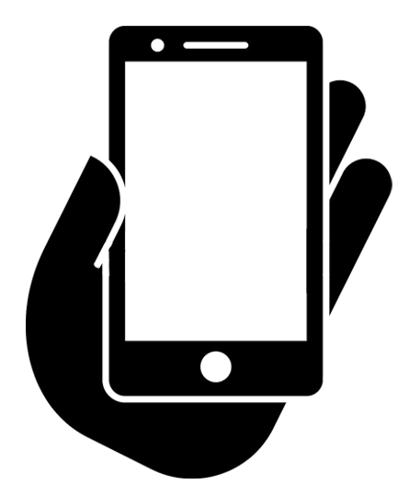

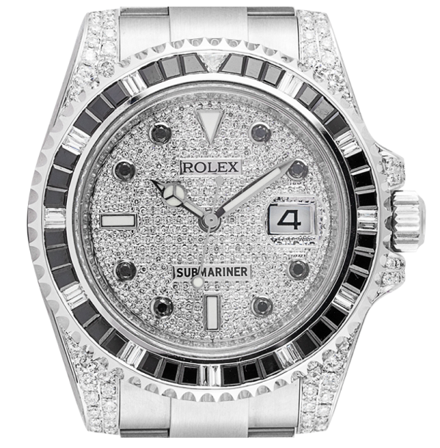


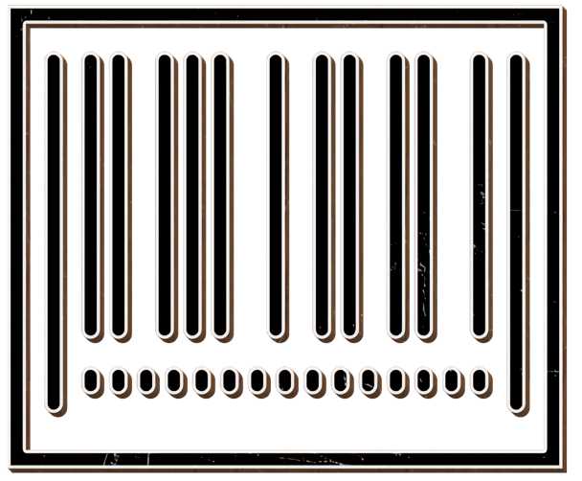
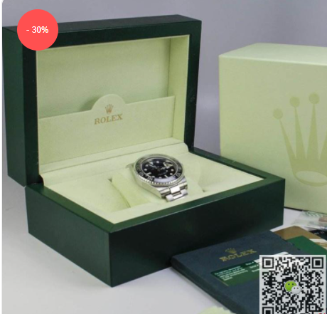
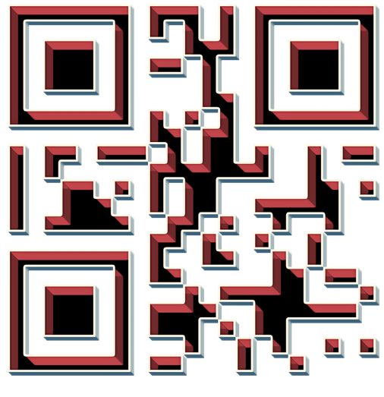

Question
Was this NFT of Submariner watch minted at Rolex Store?
Reward
1 Metasalt for creating NFT
UserName:
Salesperson
Marketplace.sol

Slide 5
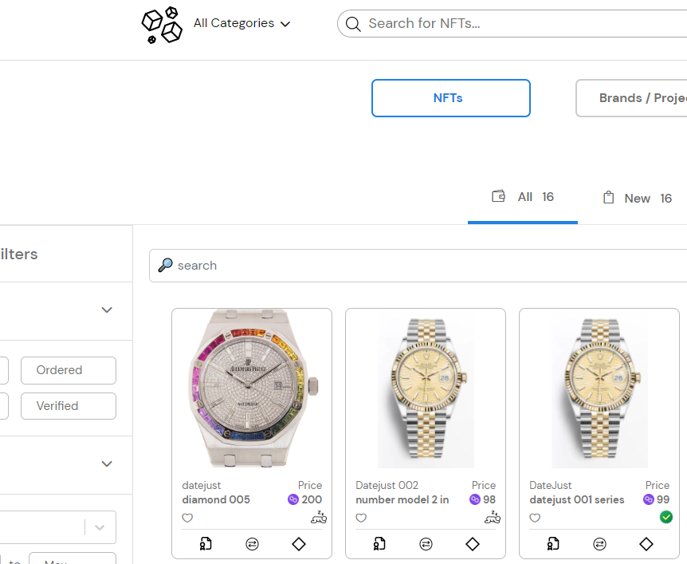
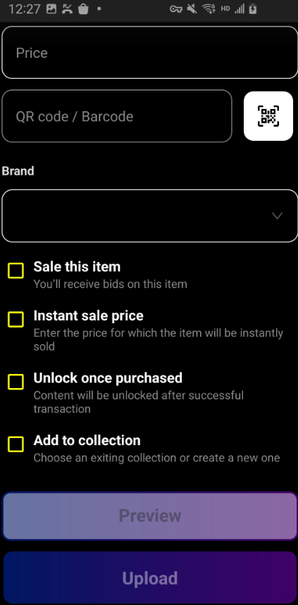
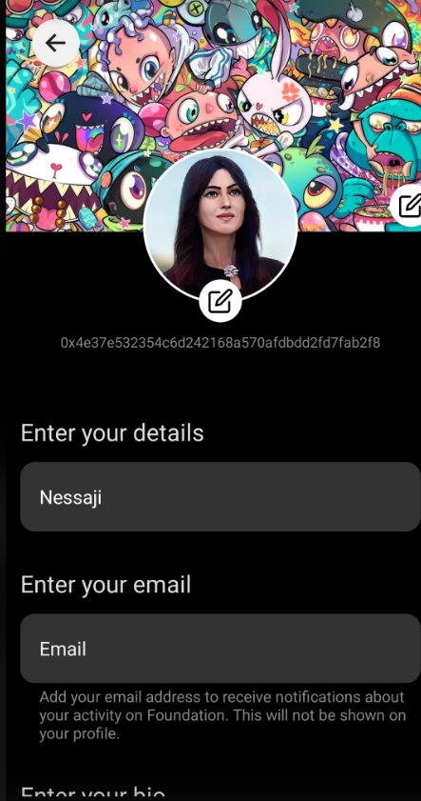
Question
How is NFT transferred to Buyer’s wallet?
?
Buyer
Salesperson

Slide 6
How is NFT transferred to Buyer’s wallet?
?
Buyer
Salesperson

Slide 7
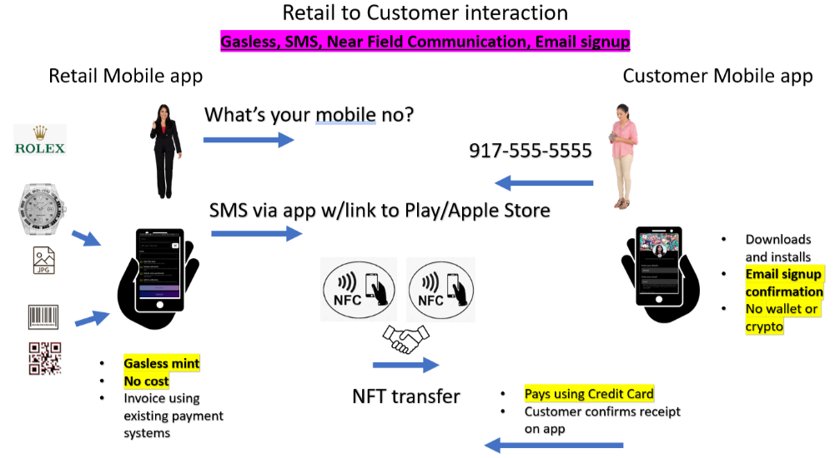

Slide 8


DB
Txn Hash
0xfdca ..
F
G
Marketplace.sol
3
4
6
8
Moralis Indexer
Brand
C
Brand
GUID
UserName
5
AnyGUID
Fee (Token)
A
Brand
Brand
E
1
Txn Hash
0xfdca….
D
B
QR Code
UserName
NFT.sol
Requestor
Authenticator. sol
QR Code
I
Brand
Hash(GUID + QR Code)
2
H
J
True/False
Brand
QR Code
7
Hash(AnyGUID + QR Code)
Blockchain

Slide 9




Metasalt DB
Brand
D
Moralis
Indexer
BrandGUID
4
QR Code
E
3
5
Txn Hash
0xfdca ..
C
Brand
BrandGUID
F
16
Brand
6
B
UserNameGUID
Brand
Marketplace.sol
NFT.sol
True/False
G
Hash(BrandGUID + QR Code)
QR Code
7
QR Code
11
8
12
A
9
ERC20
Fee (Token)
BrandGUID
13
BrandGUID
Brand
10
Brand
14
Authenticator. sol
1
2
Requestor
ERC20
Fee (Token)
ERC721
NFT Token
15
Brand
QR Code
H
Hash(BrandGUID + QR Code)
Blockchain
0x783eeb4ab271edeec0d44857e3f44208d34c8e3a5a8dbe98681fbfe536f439be

